Slide 1
EXPERIENCE SHARING ON KIT QUALITY MONITORING
RTCQI BEST PRACTICE WORKSHOP
AFRICA REGION
Petrus Katota: Ministry of Health and Social Services
Namibia
Date: June 3-7, 2024

Slide 2
Outline
Country Profile
  Background - Policy
  HIV Testing Landscape In Namibia
Components Of Quality Monitoring
HIV Rapid Test Kits Evaluated For Use In Namibia
Serial HIV Rapid Testing Algorithm Flow Chart
HTS Guidelines Review
  HIV Self Testing
  HIV Testing Strategy
Quality Control For HIV Rapid Testing
  Qcs
  RTCQI Site Assessment
QC Challenges/Gaps Identified And Mitigation Strategies
Future Plans
Acknowledgements

Slide 3

Country Profile
Namibia surface 824,116 square km
Population: 3,022,401
  51.8% Females
  48.2 Males
Geographical regions; 14
Classified upper middle income
HIV prevalence 12.6%
  15.7% Females
  9.3% Males

Slide 4
Background - Policy
Introduction of Rapid HIV Testing:
  VCT New Start Centers; 2004
  Public health facilities; 2005
First Parallel testing algorithm; 2004 - 2016
Rapid HIV Testing Task shifting policy introduced - 2005
First HIV Counseling and Testing Guidelines - 2006
  Reviewed; 2011; 2018; & 2024
RT Standard Operating Procedures (SOP) 2005; 2012; 2021
NSF (various updated editions) – 2017-2022 under revision

Slide 5
HIV Testing Landscape in Namibia
Lab services under the Directorate of Tertiary Health care and clinical support services.
  responsible for assessing labs for licencing and compliance to ISO 15189 standards for clinical laboratories-including private Labs.
Namibia Institute of pathology (NIP) a parastatal mandated by the MHSS to:
  provide Laboratory services in public facilities.
  ensure that QA standards are maintained and staff meet the competency requirements.
All HIV rapid test sites should be registered and licensed under the Hospitals and Health Facilities Act No. 36 of 1994
All HIV rapid test sites (mobile & static) are certified by NIP
All sites should enroll with the NIP QA program to be included in the regular QA assessments.
  currently 545 RT sites- all enrolled in the proficiency testing program
  Total RT Testers in RT database: 3,791

Slide 6
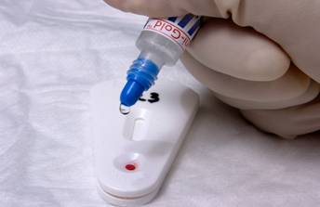
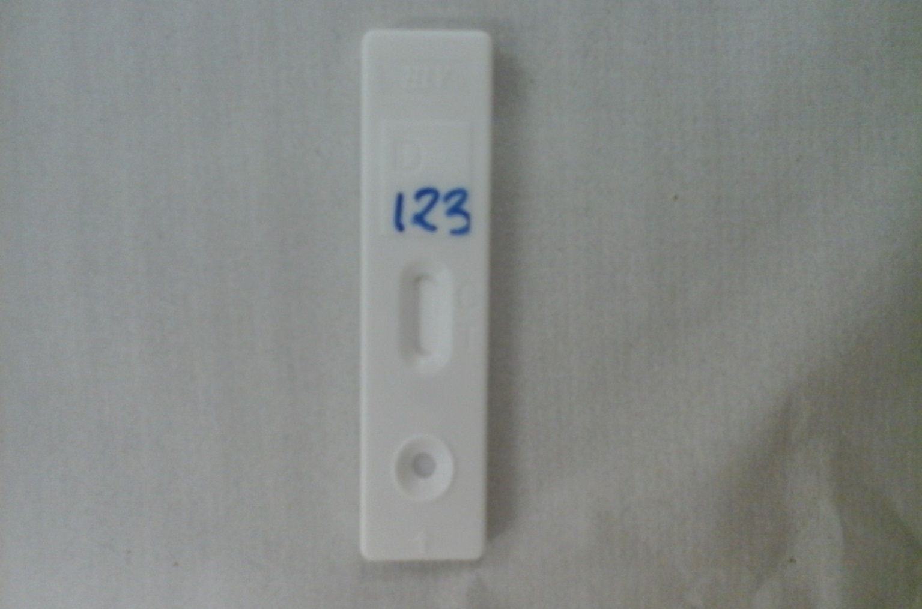
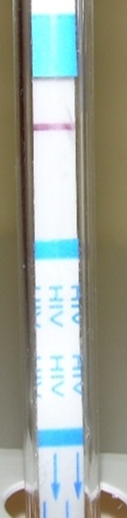
HIV Rapid Test Kits Evaluated for Use in Namibia
Colloidal Gold HIV 1/2
Uni-gold HIV 1/2
Sure Check HIV 1/2
Determine HIV 1/2
Stat Pak HIV 1/2
Clear View Complete HIV1/2
Ora-Quick
Dual HIV/Syphilis RDT

Slide 7
Current Serial HIV Rapid Testing Algorithm Flow Chart
Blood Sample
Non
-
HIV 1/2
Colloidal Gold
Reactive
Reactive
Issue
HIV NEGATIVE
Result
Non
-
Reactive
Unigold HIV
Reactive
1/2
Issue
HIV Positive
Results
Colloidal Gold
- Non-reactive
PERFORM
both
Colloidal Gold
and
Colloidal Gold
–
Reactive
Unigold
at the same time
Unigold
–
Reactive
Unigold
Non reactive
Issue HIV Negative results
–
Issue
HIV Positive
Results
Colloidal Gold
–
Reactive
Unigold
–
Non reactive
Sure Check
–
Non reactive
Perform
a 3
rd
test
Sure Check
–
Reactive
Sure Check
Report
HIV INCONCLUSIVE
Issue
HIV Negative
result
(Retest after 14 days)

Slide 8
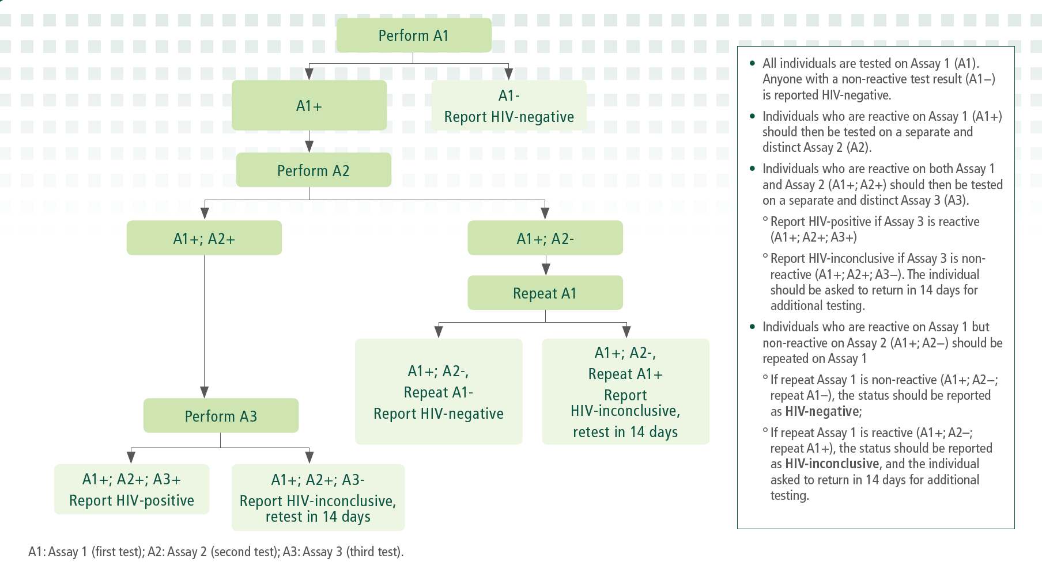
New 3-assay HIV Testing Strategy

Slide 9
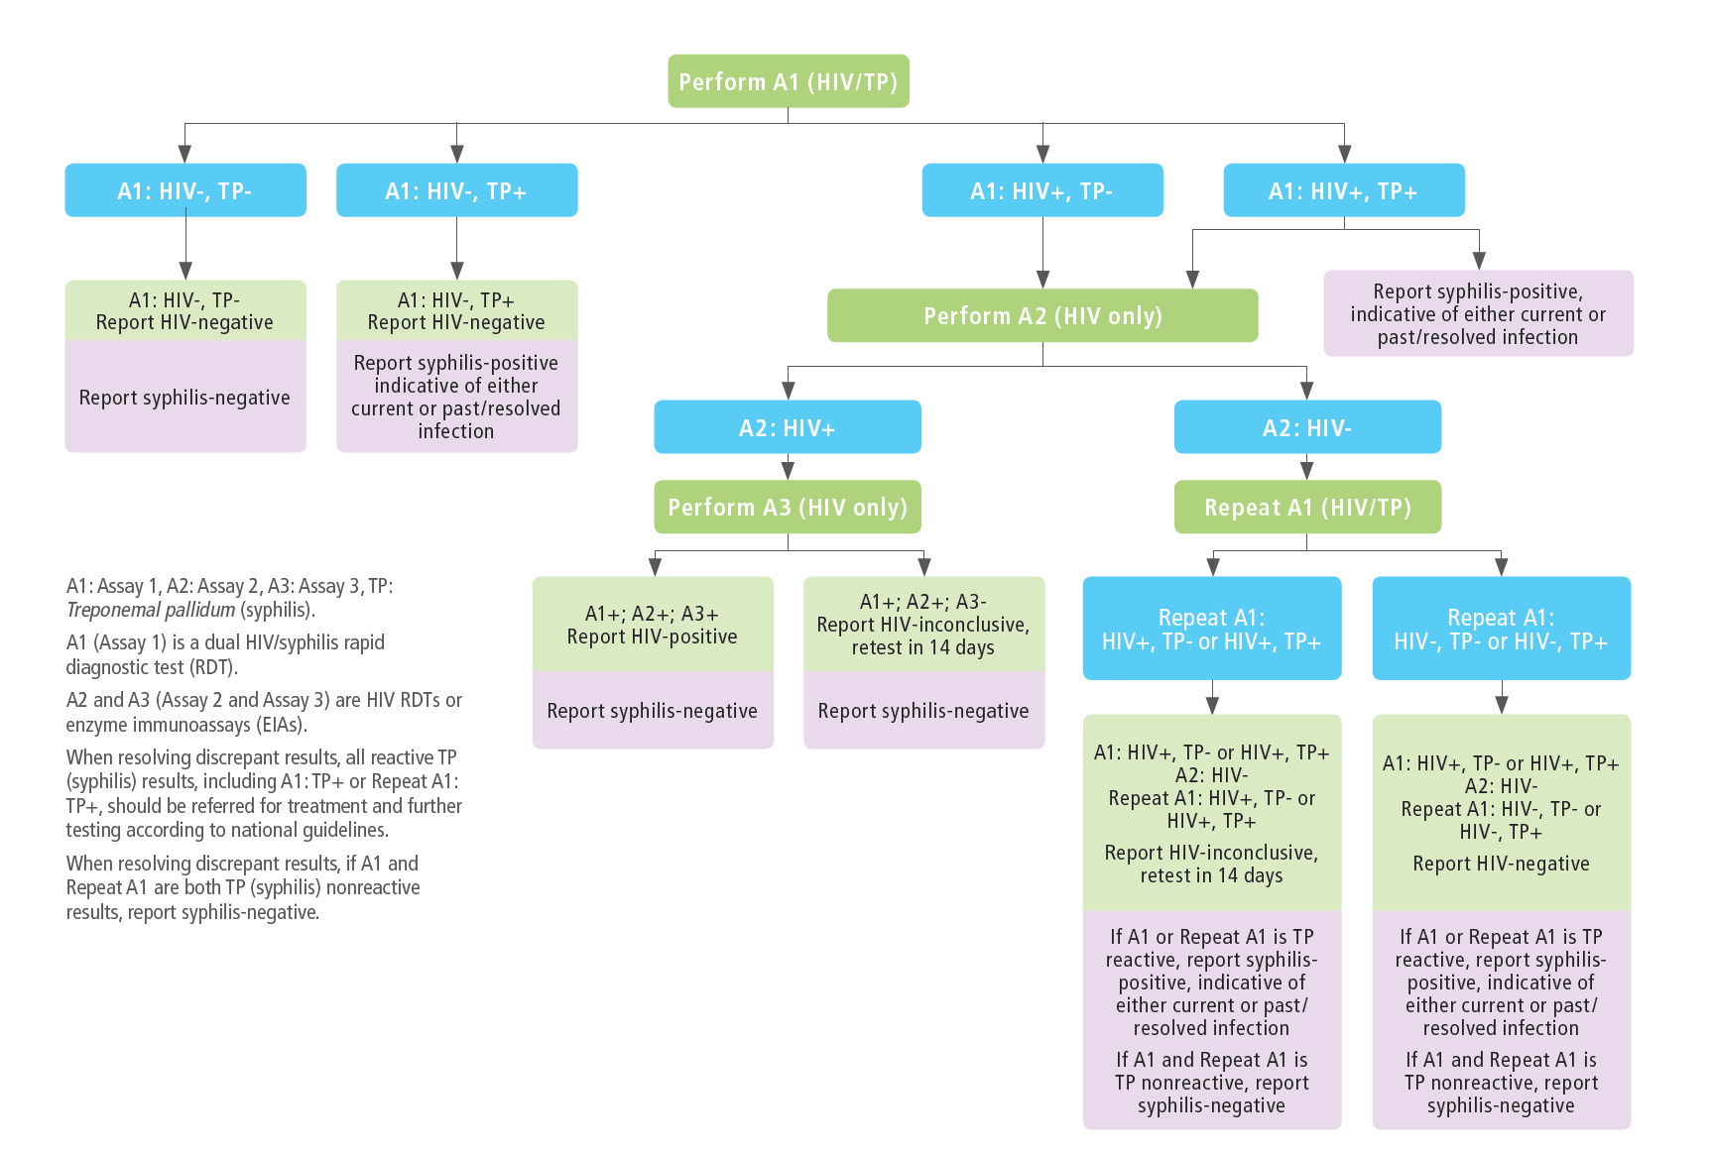
Dual HIV/Syphilis Testing Strategy
for ANC Settings
Dual HIV/Syphilis
used as A1
Dual HIV/Syphilis strategy
aligned with national
HIV testing strategy
for A2 and A3

Slide 10
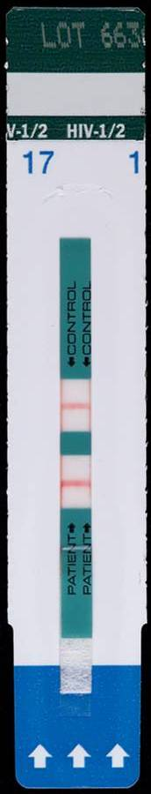
Quality Control for HIV Rapid Testing
  Preparation & Distribution of Negative/Positive Control Specimens
  Pre-tested human plasma procured by NIP from Namibia Blood Transfusion Services (NamBTS) used to prepare samples.
  Samples stored at -20°C prior to distribution to testing sites.
  Cold chain maintained using 24-hour hampers containing ice packs when samples are distributed.
  Distributed on a quarterly basis (4 lots/batches annually)
  488 sites:
    14 negative control vials per site.
    14 positive control vials per site.
    Total of 13,664 vials prepared.
  Storage conditions:
    Valid for 14 weeks (3 – 4 months) when stored at -20°C.
    Valid for 7 days when stored at 2 - 8°C.
_
+
Control line
Notes:
Step 4: Problem-Solving Invalid HIV Rapid Test Results (slides 26-29), 15 minutes
Use this slide to set up for the next slide.
The next slide has the answers to the questions posed on this slide – ask the participants “What next?” as you display this slide, then show the next slide after they have answered

Slide 11
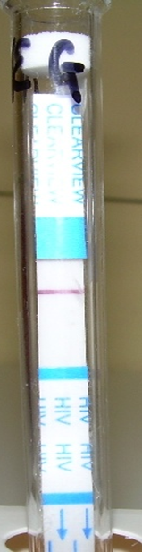
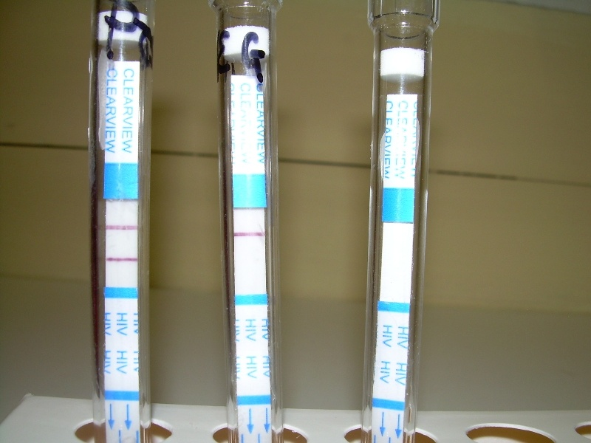
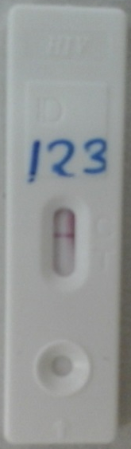
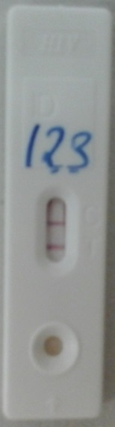
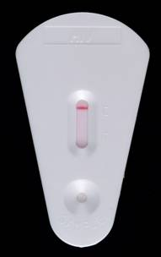
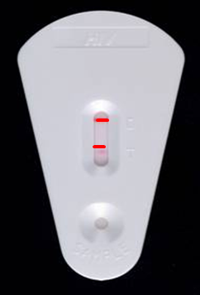
Quality Control for HIV Rapid Testing….Cont
-
Static Sites Quality Controls
  Receive batch of negative and positive control specimens (3 months’ supply)
  Place in freezer compartment of refrigerator
  QCs done:
    Once a week, at the beginning of every week
    With new stock of HIV Rapid Test kits or control materials
    Beginning a new lot number- part of PMS
    When a new HIV Rapid Tester comes to the HIV Rapid Testing site
    When temperatures in the room where kits are stored exceeds 27 ºC
  Record the results on the QC Record Sheet;
_
+
+
-
+
-
+
Notes:
Step 4: Problem-Solving Invalid HIV Rapid Test Results (slides 26-29), 15 minutes
Use this slide to set up for the next slide.
The next slide has the answers to the questions posed on this slide – ask the participants “What next?” as you display this slide, then show the next slide after they have answered

Slide 12

Proficiency Testing
NIP sends panels of “unknown” specimens to HIV Rapid Testing service providers
HIV Rapid Testing sites perform HIV Rapid Tests and provide results back to NIP
NIP provides feedback to the HIV Rapid Testing site
Results are often compared across several HIV Rapid Testing sites
After performing proficiency tests, panels are not discarded until feedback is received from NIP.
Proficiency
Testing

Slide 13
Proficiency Testing
-
Static Sites Proficiency Panels
Distributed on a quarterly basis (4 panels annually) with quality controls.
488 sites:
  3 panel samples per site to accommodate 4 testers (4 PT forms).
  Extra panel samples attached and forwarded to sites with more than 4 testers.
  Average total of 1,464 vials prepared.
  Community Based Partners
  Distributed on a quarterly basis (4 panels annually).
  690 testers:
    3 panel samples per tester.
    Total of 2,070 vials prepared.
+
-
+
-
+
Notes:
Step 4: Problem-Solving Invalid HIV Rapid Test Results (slides 26-29), 15 minutes
Use this slide to set up for the next slide.
The next slide has the answers to the questions posed on this slide – ask the participants “What next?” as you display this slide, then show the next slide after they have answered

Slide 14
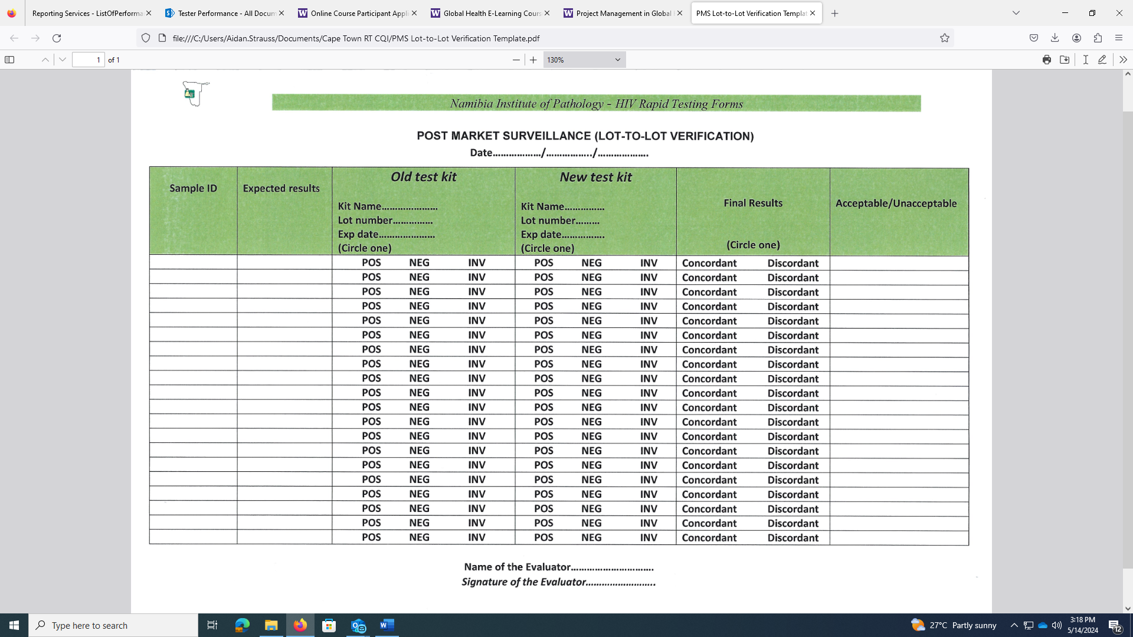
Post-Market Surveillance (PMS)
Central Level PMS (At the Reference Laboratory)
Central Medical Stores (CMS) responsible for procuring HIV test kits.
CMS works closely with NIP National Ref Laboratory to;
  ensure proactive PMS testing is conducted on all new lots of kits before they are dispatched for routine testing.
NIP is informed by CMS when new lot of HIV test kits are received.
NIP randomly selects 20 testing devices from the new lot;
  use them to test well characterized samples (i. samples with known HIV results, ii. at least ten (10) should be HIV-positive, iii. same samples to be used for new lots of test kits).
When test devices are able to yield the expected results;
  The lot is deemed to have met the standard
  Explicit records for PMS testing are maintained.

Slide 15
Post-Market Surveillance (PMS) cont’d
Site Level PMS (Internal Quality Control (IQC))
PMS at the point of HIV testing is achieved through the analysis of IQC samples.
IQC samples are prepared at NIP QA laboratory and dispatched to all sites conducting HTS on a quarterly basis, using pre-tested HIV- positive and negative plasma.
Whenever test kits fail to yield expected results on IQC samples, this is recorded as an occurrence and reported to the Reference Laboratory.

Slide 16
Post-Market Surveillance (PMS) Summary
Key Findings
  100% concordance achieved with all RT kits in the last 3 years.
Lessons Learned
Frequency
  IQC – Quarterly basis.
  Central Level PMS – New lot of testing kits procured by CMS.
Efficiency
  Assurance of new lot of RT kits meeting standards and approval given to distribute test kits for routine testing.

Slide 17
Rapid Testing Onsite Assessment
ITECH conducts annual HIV Rapid Testing site visits
A systematic review of HIV Rapid Testing site operations and quality procedures
Information collected for:
  Planning and implementation
  Monitoring
  Continuous improvement
  Updating information
Onsite
Assessment

Slide 18
RTCQI: Data Collection and Analysis
RT Site Assessments are conducted using a 75-point SPI-RT checklist (adopted from the CDC SPI-RT checklist).
  It evaluates QA processes and site-level performance and compliance with set standards.
Combining paper (SPI-RT) and electronic (REDCap) tools:
  Onsite assessments are conducted to identify gaps in the Quality Management System for Point-of-Care (POC) HIV testing.
Corrective action is taken at the facility level where possible, or a plan is developed by the relevant staff at the facility, district, or regional level.
The effectiveness of these actions and Continuous Quality Improvement (CQI) efforts is monitored through timely follow-up visits or by phone.

Slide 19
RTCQI site assessments:
Oct. 22-Sept. 2023 Program and Technical Elements

Slide 20
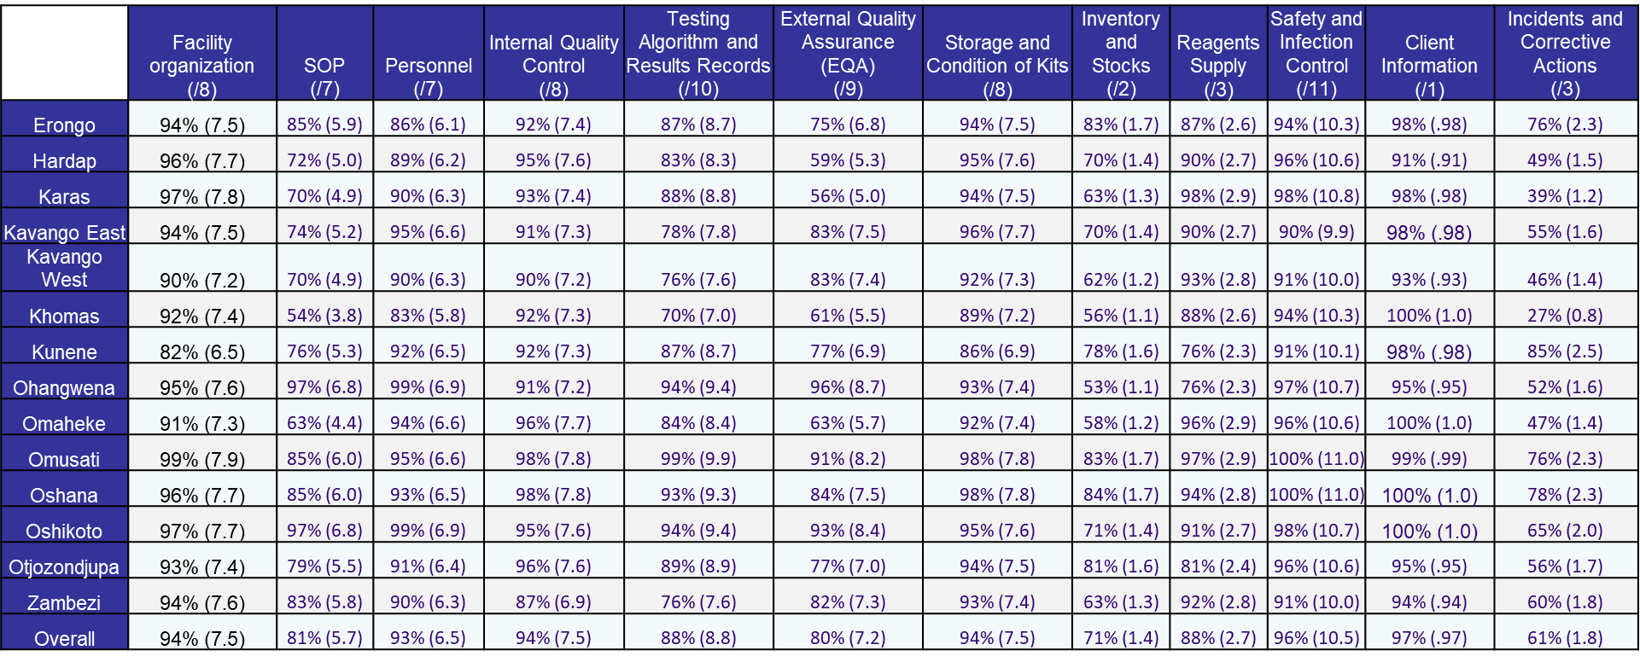
RTCQI site assessments:
Oct. 22-Sept. 2023 Program and Technical Elements
Average score for Internal Quality Control was 94%
Scores for IQC range from 87% to 98%

Slide 21
QC Challenges/Gaps Identified
Poor documentation:
  Absence of copies to document QC activities
One tester persistently performing QCs.
  Nurses rarely perform and if Health Assistant is not onsite
    RT testing often takes place without performing QCs
QC protocols not adhered to:
  QC samples retaining for weekly usage not observed
Use of one pipette on both kits when performing QCs
Incubation time for Colloidal Gold not observed consistently:
  reading results early or long after the recommended time

Slide 22
Mitigation Strategies
Enhanced Training, Capacity Building and Supervision
  Onsite mentorship for service providers:
    Conducting Site Assessments/Audits, Mentoring, Quality Improvement and Tester Competency Assessments.
HTS Mentors Virtual Platforms:
  Monthly Peer Learning series via Zoom for HTS providers RTCQI-focused topics and sharing experiences between facilities and providers.

Slide 23
Future plans
Expansion: HTS Mentors Virtual Platforms:
  Monthly Peer Learning series via Zoom for HTS providers RTCQI-focused topics and sharing experiences between facilities and providers.

Slide 24




Acknowledgement
Aidan Strauss Namibia Institute of Pathology
Farai Munyayi International Training and Education Center for Health (I-TECH) University of Washington
Edington Dzinotyiweyi Ministry of Health and Social Services, Namibia
Anita Beukes, Martin Steinau CDC-Namibia
This project has been supported by the President's Emergency Plan for AIDS Relief (PEPFAR) through the Centers for Disease Control and Prevention (CDC).

Slide 25


